Slide 1


Chapter 6
HEAT CAPACITY, ENTHALPY, ENTROPY, AND THE THIRD LAW OF THERMODYNAMICS
6.1 INTRODUCTION
Eqs. (2.6) and (2.7) defined two heat capacities, the heat capacity at constant volume
(2.6)
and the heat capacity at constant pressure
(2.7)
At this point it is convenient to introduce a notation which allows distinctions to be made between the values of extensive properties per mole of a system and the values of the extensive properties for the entire system. If E is an extensive property, then E′ will be used to denote the value of the property for the entire system containing n moles, and E will be used to denote the value of the property per mole of the system. Thus E is the molar value of the property and, for a system containing n moles,
Eqs. (2.6) and (2.7) can thus be written equivalently as
(2.6a)
(2.7a)
in which C_{p} and C_{v} are, respectively, the constant-pressure, and constant-volume molar heat capacities. Integration of Eq. (2.7a) between the states (T₂, P) and (T₁, P) gives the difference between the molar enthalpies of the two states as

Slide 2


126 Introduction to the Thermodynamics of Materials
(6.1)
from which it is seen that a knowledge of the variation of C_{p} with temperature is required
for determination of the temperature dependence of enthalpy, and, as will be seen, for the determination of the temperature dependence of entropy. Similarly, integration of Eq. (2.6a) between T₂ and T₁ at constant volume shows that knowledge of the variation of C_{v}
with temperature is required for determination of the temperature dependence of internal energy.
6.2 THEORETICAL CALCULATION OF THE HEAT CAPACITY
As a result of experimental measurement, Dulong and Petit introduced an empirical rule in 1819 which states that the molar heat capacities of all solid elements have the value 3R(=24.9 J/K), and, in 1865, Kopp introduced a rule which states that, at ordinary temperatures, the molar heat capacity of a solid chemical compound is approximately equal to the sum of molar heat capacities of its constituent chemical elements. Although the molar heat capacities of most elements at room temperature have values which are very close to 3R, subsequent experimental measurement shows that heat capacity usually increases with increasing temperature and can have values significantly lower than 3R at low temperatures. Fig. 6.1 shows that, although lead and copper closely obey Dulong and Petit’s rule at room temperature, the constant-volume heat capacities of silicon and diamond are significantly less than 3R. Fig. 6.1 also shows the significant decrease in the heat capacities at low temperatures.
Calculation of the heat capacity of a solid element, as a function of temperature, was one of the early triumphs of the quantum theory. The first such calculation was made in 1907 by Einstein, who considered the properties of a crystal containing n atoms, each of which behaves as a harmonic oscillator vibrating independently about its lattice point. As the behavior of each oscillator is not influenced by the behavior of its neighbors, each oscillator vibrates with a single fixed frequency v, and a system of such oscillators is called an Einstein crystal.
Quantum theory gives the energy of the ith energy level of a harmonic oscillator as
(6.2)
in which i is an integer which has values in the range zero to infinity, and h is Planck’s constant of action. As each oscillator has three degrees of freedom, i.e., can vibrate in the x, y, and z directions, the energy, U′, of the Einstein crystal (which can be considered to be a system of 3n linear harmonic oscillators) is given as

Slide 3
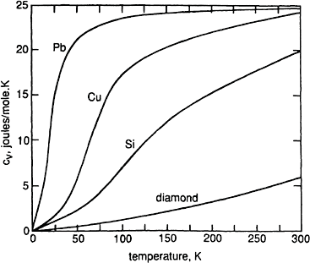
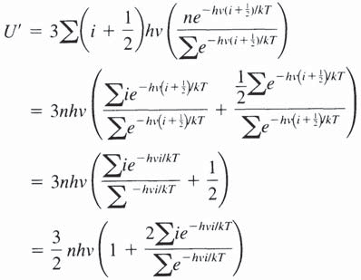
Heat Capacity, Enthalpy, Entropy, and the Third Law of Thermodynamics 127
(6.3)
Figure 6.1 The constant-volume molar heat capacities of Pb, Cu, Si, and diamond as functions of temperature.
where, as before, n_{i} is the number of atoms in the ith energy level. Substituting Eqs. (6.2) and (4.13) into Eq. (6.3) gives

Slide 4


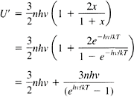
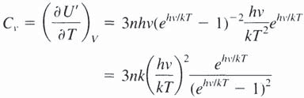
128 Introduction to the Thermodynamics of Materials
Taking
where x=e^{–hv/kT}, gives
and
in which case
(6.4)
Eq. (6.4) gives the variation of the energy of the system with temperature, and differentiation of Eq. (6.4) with respect to temperature at constant volume gives, by definition, the constant-volume heat capacity C_{v}. Maintaining a constant volume causes
constant quantization of the energy levels. Thus
Defining hv/k=0_{E}, where 0_{E} is the Einstein characteristic temperature, and taking n equal to Avogadro’s number, gives the constant-volume molar heat capacity of the crystal as

Slide 5

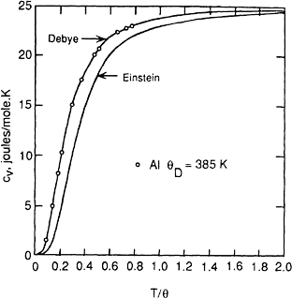
Heat Capacity, Enthalpy, Entropy, and the Third Law of Thermodynamics 129
(6.5)
The variation of C_{v} with T/0_{E} is shown in Fig. 6.2, which shows that as T/0_{E} (and hence
T) increases, C_{v} → 3R in agreement with Dulong and Petit’s law, and as T → 0, C_{v} → 0, which is in agreement with experimental observation. The actual value of 0_{E} for any
element and its vibration frequency, v, are obtained by curve-fitting Eq. (6.5) to experimentally measured heat capacity data. Such curve-fitting, which is shown in Fig. 6.2, shows that although the Einstein equation adequately represents actual heat capacities at higher temperatures, the theoretical values approach zero more rapidly than do the actual values. As T/0_{E} decreases from 0.02 to 0.01 the theoretical molar heat
capacity decreases from 1.2×10^{–17} to 9.3×10^{–39} J/K. This discrepancy is caused by the fact that the oscillators do not vibrate with a single frequency.
The next step in the theory was made in 1912 by Debye, who assumed that the range of frequencies of vibration available to the oscillators is the same as that available to the elastic vibrations in a continuous solid. The lower limit of these vibrations is determined by the interatomic distances in the solid, i.e., if the wavelength is equal to the interatomic distance then neighboring atoms would be in the same phase of vibration and, hence, vibration of one atom with respect to another would not occur.
Figure 6.2 Comparison among the Debye heat capacity, the Ein-stein heat capacity, and the actual heat capacity of aluminum.

Slide 6



130 Introduction to the Thermodynamics of Materials
Theoretically, the shortest allowable wavelength is twice the interatomic distance, in which case neighboring atoms vibrate in opposition to one another. Taking this minimum
wavelength, Z , to be in the order of 5×10^{–8} cm, and the wave velocity, v, in the solid to
min
be 5×10⁵ cm/sec, gives the maximum frequency of vibration of an oscillator to be in the order of
Debye assumed that the frequency distribution is one in which the number of vibrations per unit volume per unit frequency range increases parabolically with increasing frequency in the allowed range 0≤v≤v_{max}, and, by integrating Einstein’s equation over
this range of frequencies, he obtained the heat capacity of the solid as
which, with x=hv/kT, gives
(6.6)
where V_{D} (the Debye frequency)=v_{max} and 0_{D}=hv_{D}/k is the characteristic Debye temperature of the solid.
Eq. (6.6) is compared with Einstein’s equation in Fig. 6.2, which shows that Debye’s equation gives an excellent fit to the experimental data at lower temperatures. Fig. 6.3 shows the curve-fitting of Debye’s equation to the measured heat capacities of Pb, Ag, Al, and diamond. The curves are nearly identical except for a horizontal displacement and the relative horizontal displacement is a measure of 0_{D}. When plotted as C_{v} versus log T/0_{D}, all of the datum points in Fig. 6.3 fall on a single line.

Slide 7
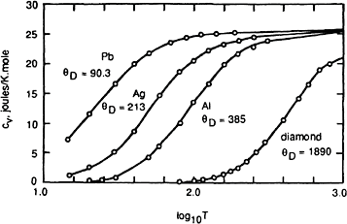

Heat Capacity, Enthalpy, Entropy, and the Third Law of Thermodynamics 131
Figure 6.3 The constant-volume molar heat capacities of several solid elements. The curves are the Debye equation with the indicat- ed values of 0_{D}.
The value of the integral in Eq. (6.6) from zero to infinity is 25.98, and thus, for very low temperatures, Eq. (6.6) becomes
(6.7)
which is called the Debye T³ law for low-temperature heat capacities.
Debye’s theory does not consider the contribution made to the heat capacity by the uptake of energy by electrons, and, since C_{v}=(6U/6T)_{v}, it follows that a contribution to
the heat capacity will be made in any range of temperature in which the energy of the electrons changes with temperature. The electron gas theory of metals predicts that the electronic contribution to the heat capacity is proportional to the absolute temperature, and thus the electronic contribution becomes large in absolute value at elevated temperatures. Thus, at high temperatures, where the lattice contribution approaches the Dulong and Petit value, the molar heat capacity should vary with temperature as
in which bT is the electronic contribution. Theoretical calculation of the value of the coefficient b is made difficult by a lack of knowledge of the number of electrons per atom present in the electron gas. Also, the theoretical approach to heat capacities does not consider the contribution made by the anharmonicity of the lattice vibrations at elevated
vtemperatures.

Slide 8
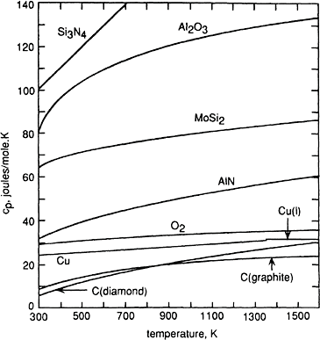
132 Introduction to the Thermodynamics of Materials
As a consequence of the various uncertainties in the theoretical calculation of heat capacities, it is normal practice to measure the variation of the constant-pressure molar heat capacity with temperature and express the relationship analytically.
Figure 6.4 The variations, with temperature, of the constant- pressure heat capacities of several elements and compounds.
6.3 THE EMPIRICAL REPRESENTATION OF HEAT CAPACITIES
The experimentally measured variation of the constant-pressure molar heat capacity of a material with temperature is normally fitted to an expression of the form
and it should be noted that the analytical expression is only applicable in that stated temperature range over which the values of the heat capacity were measured. For example ZrO₂ exists as monoclinic a-ZrO₂ from room temperature to 1478 K and as

Slide 9
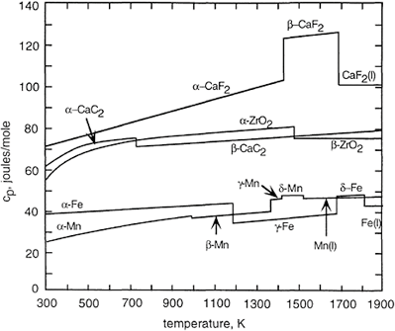
Heat Capacity, Enthalpy, Entropy, and the Third Law of Thermodynamics 133
tetragonal ß-ZrO₂ in the range of temperature 1478–2670 K and each polymorph has its own equation giving the variation of its heat capacity with temperature.
over the temperature range 298–1478 K, and
from 1478 to 2670 K. In fitting the analytical expression to the measured heat capacities all of a, b, and c have non-zero values in the expression for a-ZrO₂, whereas the
Figure 6.5 The variations, with temperature, of the constant-pressure molar heat capacities of some elements which exhibit allotropy and some compounds which exhibit polymorphism.
molar heat capacity of ß-ZrO₂ is independent of temperature, in which case b and c are zero in the analytical expression. The variations, with temperature, of C_{p} for several
elements and compounds which do not undergo phase transitions in the solid state are shown in Fig. 6.4, and the variations for some elements which exhibit allotropy and compounds which exhibit polymorphism are shown in Fig. 6.5. The data for a-ZrO₂ and ß-ZrO₂ are included in Fig. 6.5.

Slide 10

134 Introduction to the Thermodynamics of Materials
6.4 ENTHALPY AS A FUNCTION OF TEMPERATURE AND COMPOSITION
For a closed system of fixed composition undergoing a change in temperature from T₁ to
T₂ at the constant pressure P, integration of Eq. (2.7) gives Eq. (6.1):
(6.1)
OH is thus the area under a plot of C_{p} vs. T between the limits T₁ and T ₂, and, from Eq. (2.7), OH=q_{p}, which is simply the amount of heat required to increase the temperature of 1 mole of the system from T₁ to T₂ at the constant pressure P.
When a system undergoes a chemical reaction or a phase transformation at constant temperature and pressure, e.g., the reaction A+B=AB, OH is the difference between the enthalpy of the products of the reaction (the state 2), and the enthalpy of the reactants (the state 1), i.e.,
(6.8)
and Eq. (6.8) is a statement of Hess’s law. If OH is a positive quantity the reaction causes the system to absorb heat from its thermostatting heat bath, and the reaction is thus endothermic. Conversely, if OH is a negative quantity the reaction occurs with an evolution of heat and is thus an exothermic process. This convention is the same as that used with the First Law for the sign of q, the heat entering or leaving the system.
Changes in enthalpy caused by changes in temperature and/or composition can be graphically represented on an enthalpy-temperature diagram. Consider the change of state
i.e., the melting of pure A. OH_{T1} for this process is the difference between the molar enthalpies of liquid and solid A at the temperature T₁:
This change in enthalpy is represented by line ba in Fig. 6.6. For the change of phase occurring at the temperature T₂,

Slide 11




Heat Capacity, Enthalpy, Entropy, and the Third Law of Thermodynamics 135
which is represented in Fig. 6.6 by the line of cd. As H is a state function, then
(i) where OH(a ‹ d) is the heat required to increase the temperature of one mole of solid A
from T₁ to T₂ at constant pressure.
in which d_{pA(s)} is the molar heat capacity of solid A
OH(c ‹ b) is the heat which is evolved by 1 mole of liquid A when its temperature is decreased from T₂ to T₁ (or the negative of the amount of heat required to raise the
temperature of a mole of liquid A from T₁ to T₂)
in which C_{pA(l)} is the molar heat capacity of liquid A. Substitution of the individual expressions into Eq. (i) gives
or
(6.9)
where

Slide 12
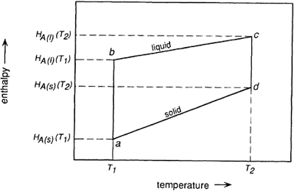
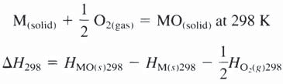
136 Introduction to the Thermodynamics of Materials
Thus if the heat of the reaction is known at one temperature and the constantpressure heat capacities of the products and the reactants are known (along with their dependencies on temperature), then the heat of the reaction at any other temperature can be calculated. It is
to be noted that if OC_{p}=0, then i.e., the heat of the reaction, OH, is in- dependent of temperature. In Fig. 6.6 the slope of the line bc, which is (6H/6T)_{p}, is C_{p}, for the liquid A, and bc is a straight line only if C_{p} is independent of temperature.
As H does not have an absolute value (only changes in H can be measured), it is convenient to introduce a convention which will allow the comparison of different enthalpy-temperature diagrams. This convention assigns the value of zero to the enthalpy of elements in their stable states at 298 K (25°C). Thus the enthalpy of a compound at
Figure 6.6 The variation, with temperature, of the molar enthalpies of the solid and liquid phases of a substance.
298 K is simply the heat of formation of the compound from its elements at 298 K. For example, for the oxidation
and, as H_{M.298} and
, are by convention, equal to zero, then

Slide 13

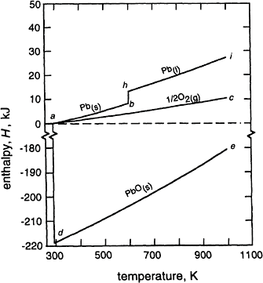
Heat Capacity, Enthalpy, Entropy, and the Third Law of Thermodynamics 137
The variation of heats of chemical reaction (or heats of formation) with temperature at constant pressure can be represented on an enthalpy-temperature diagram such as Fig. 6.7, which is drawn for the oxidation
The pertinent thermochemical data for this system are listed in Table 6.1. In Fig. 6.7a, a
represents the enthalpy of mole of oxygen gas and 1 mole of Pb_{(s)} at 298 K ( = 0 by convention); ab represents the variation of H_{Pb(s)} with temperature in the
Figure 6.7 (a) The variation, with temperature, of the enthalpies of Pb_{(s)}, Pb_{(l)},
, and PbO_{(s)}.

Slide 14
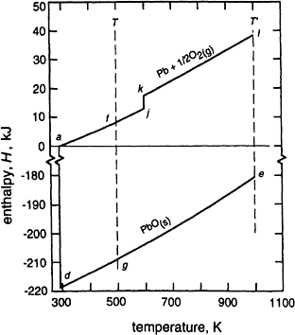

138 Introduction to the Thermodynamics of Materials
Figure 6.7 (b) The variation, with temperature, of the enthalpies of ( and PbO.
)
range 298≤T≤600, where H_{Pb(s)}, T is given by ac represents variation of with temperature in the range 298≤T≤3000 K, where is given by
; OH_{PbO(s),298 K}=–219,000 J; and de represents the variation of H_{PbO(s)}
with temperature in the range 298 K≤T≤1159 K where
In Fig. 6.7b, a represents the enthalpy of mole of O_{2(g)} and 1 mole of Pb_{(s)} at 298 K; f
represents the enthalpy of mole of O_{2(g)} and 1 mole of Pb(s) at the temperature T; and g
represents the enthalpy of 1 mole of PbO_{(s)} at the temperature T.

Slide 15


Heat Capacity, Enthalpy, Entropy, and the Third Law of Thermodynamics 139
Thus
and thus
Table 6.1 Thermochemical data for Pb, PbO, and O₂.
H_{PbO(298)}=–219,000 J/K
_{C} –3
_{p},_{Pb(s)}=23.6+9.75×10 T J/K from 298 K to T_{m,Pb}
Cp,_{Pb} = 32.4–3.1×0^{–3}T J/K from T to 1200 K
(l) m,Pb
_{C} –3
_{p,PbO(s)}=37.9+26.8×10 T J/K from 298 K to T_{m,PbO}
_{C} –3 5 –2
_{p},_{O2(g)}=29.96+4.18×10 T–1.67×10 T J/K from 298 K to 3000 K
OH_{m,Pb}=4810 J at T_{m,Pb}=600 K
T_{m},_{PhO}=1159 K
where
From the data in Table 6.1,
and, thus, in the range of temperature from 298 to 600 K (T_{m,Pb}),

Slide 16
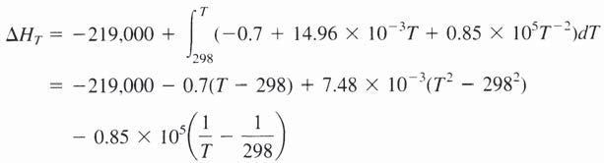


140 Introduction to the Thermodynamics of Materials
With T=500 K, this gives OH_{500 K}=–217,800 J, as can be seen in Figs. 6.1b and 6.8. If a
phase change occurs in one or more of the reactants or products, between the two temperatures at which the reaction is being considered, then the latent heats of the phase changes must be considered. In Fig. 6.7a, h represents the enthalpy of 1 mole of Pb_{(l)} at
the melting temperature of 600 K, given as
hb is the latent heat of melting of Pb at the melting temperature of 600 K (=4810 J); and
hi represents the variation of the enthalpy of 1 mole of Pb_{(l)} with temperature in the range
600 to 1200 K:
In Fig. 6.7b, ajkl represents the variation of the enthalpy of 1 mole of Pb and mole of O_{2(g)}, and hence OH_{T′} is calculated from the cycle

Slide 17
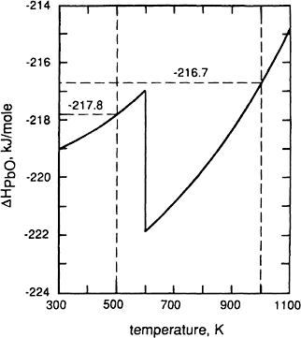
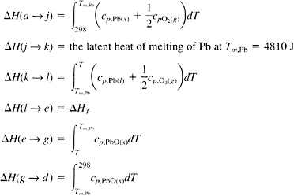
Heat Capacity, Enthalpy, Entropy, and the Third Law of Thermodynamics 141
Figure 6.8 The variation, with temperature, of the enthalpy change for
the reaction
.
where

Slide 18

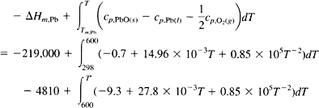
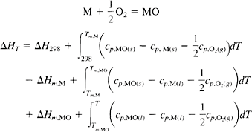
142 Introduction to the Thermodynamics of Materials
Thus
This gives OH₁₀₀₀=–216,700 joules at T′=1000 K, as is seen in Figs. 6.7b and 6.8. Fig.
6.8 shows the variation of OH_{PbO,T} with temperature in the range 298–1100 K.
If the temperature of interest is higher than the melting temperatures of both the metal and its oxide, then both latent heats of melting must be considered. For example, with reference to Fig. 6.9, which is drawn for the general oxidation,

Slide 19
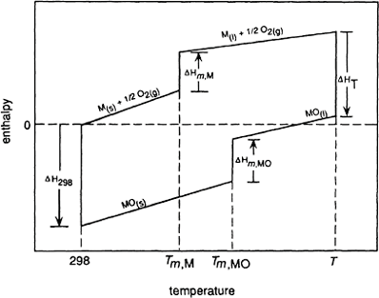

Heat Capacity, Enthalpy, Entropy, and the Third Law of Thermodynamics 143
Figure 6.9 The effect of phase changes on OH for a chemical reaction.
When phase transformations of the reactants or products have to be considered, care must be taken with the signs of the changes in enthalpy. The signs can be obtained from a consideration of Le Chatelier’s principle, which states that “when a system, which is at equilibrium, is subjected to an external influence, the system moves in that direction which nullifies the effects of the external influence.” Thus if the system contains a low-temperature phase in equilibrium with a high-temperature phase at the equilibrium phase transition temperature, such as a solid coexisting with a liquid at the equilibrium melting temperature, then introduction of heat to the system (the external influence) would be expected to increase the temperature of the system (the effect). However, the system undergoes an endothermic change, which absorbs the heat introduced at constant temperature, and hence nullifies the effect of the external in- fluence. The endothermic process is the melting of some of the solid. A phase change from a low- to a high-temperature phase is always endothermic, and hence OH for the change is always a positive quantity. Thus OH_{m}, the molar latent heat of melt- ing, which is the difference between the enthalpy of a mole of liquid and the enthalpy of a mole of solid, is always positive. The general Eq. (6.9) can be obtained as follows:

Slide 20





144 Introduction to the Thermodynamics of Materials
Subtraction gives
or
(6.10)
and integrating from state 1 to state 2 gives
(6.11)
Equations (6.10) and (6.11) are expressions of Kirchhoff ’s Law.
6.5 THE DEPENDENCE OF ENTROPY ON TEMPERATURE AND THE THIRD LAW OF THERMODYNAMICS
For a closed system undergoing a reversible process, the Second Law gives
(3.8)
If the process is conducted at constant pressure, then
and thus if the temperature of a closed system of fixed composition is increased from T₁ to T₂ at constant pressure, the increase in the entropy per mole of the system, OS, is given by

Slide 21



Heat Capacity, Enthalpy, Entropy, and the Third Law of Thermodynamics 145
(6.12)
This change of entropy is obtained the area under a plot of C_{p}/T vs. T between the limits T₂ and T₁, or, equivalently, as the area under a plot of C_{p} vs. In T between the limits In T₂ and In T₁. Generally, S_{T,} the molar entropy of the system at any temperature T is given by
(6.13)
where S₀ is the molar entropy of the system at 0 K. Consideration of the value of S₀ leads
to the statement of what is commonly called the Third Law of Thermodynamics. In 1906 Nernst postulated that, for chemical reactions between pure solids or pure liquids, the terms
approach zero as temperature approaches absolute zero. For any change in the state of a system, e.g., a chemical reaction at the constant temperature T, Eq. (5.2) gives
and thus Nernst’s postulate is that OG for the reaction varies with temperature as shown in Fig. 6.10. The slope of the line in Fig. 6.10, at any temperature is equal to –OS_{T}, and
the intercept, with the OG axis at T=0, of the tangent to the line at any temperature is equal to OH_{T}, the change in the enthalpy at the temperature T. As the temperature
approaches zero, the slope of the line approaches zero and the variation of the tangential intercept with temperature approaches zero, the consequences of which are that, as

Slide 22
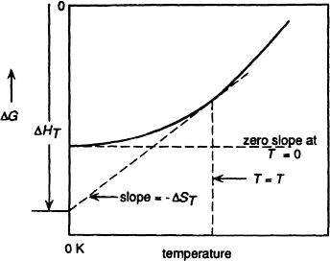



146 Introduction to the Thermodynamics of Materials
Figure 6.10 The variation of the change in the Gibbs free energy for a reac- tion with temperature as the temperature approaches absolute zero.
T → 0, then ΔS → 0 and ΔC_{p} → 0. This can be seen by differentiating Eq. (5.2) with respect to T at constant P:
From Eq. (5.12)
and thus
Thus if (∂ΔG/∂T)P and (∂ΔH/∂T)p approach zero as T → 0, the values of ΔS and ΔCp approach zero as T → 0 (provided that (∂ΔS/∂T)p is not innite at T=0).
Nernst’s heat theorem states that “for all reactions involving substances in the condensed state, ΔS is zero at the absolute zero of temperature.” Thus, for the general reaction

Slide 23
Heat Capacity, Enthalpy, Entropy, and the Third Law of Thermodynamics 147
OS=S_{AB}–S_{A}–S_{B}=0 at T=0, and if S_{A} and S_{B} are assigned the value of zero at 0 K, then the compound AB also has zero entropy at 0 K.
The incompleteness of Nernst’s theorem was pointed out by Planck, who stated that “the entropy of any homogeneous substance, which is in complete internal equilibrium, may be taken to be zero at 0 K.” The requirement that the substance be in complete internal equilibrium can be illustrated as follows:
Glasses are noncrystalline solids which can be regarded as being supercooled liquids in which the disordered atomic arrangements occurring in the liquid state have been “frozen into” the solid state. Substances which form glasses usually have complex atomic, ionic, or molecular structures in the liquid state, and the structures would require extensive atomic reorganization in order to assume the periodic structure characteristic of the crystalline state. In the absence of the ability of the glass-forming substance to undergo the necessary atomic rearrangement at a unique freezing temperature, the liquid on cooling simply becomes more and more viscous and eventually forms a solid glass. If the solid glass were to crystallize, its enthalpy, internal energy, and entropy would decrease, and the decreases in the enthalpy and entropy would be, respectively, the latent heat and entropy of crystallization at the temperature at which devitrification occurred. At temperatures lower than its equilibrium freezing tem- perature the glassy state is metastable with respect to the crystalline state, and a glass, not being in internal equilibrium, has an entropy at 0 K which is greater than zero by an amount which is dependent on the degree of atomic disorder in the glass.
Solutions are mixtures of atoms, ions, or molecules, and a contribution is made to their entropies by the fact that they are mixtures [see Eq. (4.18)]. This contribution is called the entropy of mixing and is determined by the randomness with which the particles are mixed in the solution. The atomic randomness of a mixture determines its degree of order, e.g., in a mixture containing 50 atomic percent of A and 50 atomic percent of B, complete ordering occurs when every atom of A is coordinated only by B atoms and vice versa, and complete randomness occurs when, on average, 50 percent of the neighbors of every atom are A atoms and 50 percent are B atoms. Respectively, the degrees of order in these two extreme configurations are unity and zero. The equilibrium degree of order is temperature-dependent and increases with decreasing temperature. However, the maintenance of the equilibrium degree of order is dependent on the abilities of the particles to change their positions in the solu- tion, and, with ever-decreasing temperature, as atomic mobility decreases exponential- ly with decreasing temperature, the maintenance of internal equilibrium becomes in- creasingly difficult. Consequently a nonequilibrium degree of order can be frozen into the solid solution, in which case the entropy will not decrease to zero at 0 K.
Even chemically pure elements are mixtures of isotopes, and because of the chemical similarity between isotopes it is to be expected that completely random mixing of the isotopes occurs. Thus an entropy of mixing occurs, and consequently, the entropy does not decrease to zero at 0 K. For example, solid chlorine at 0 K is a solid solution of Cl³⁵—Cl³⁵, Cl³⁵—Cl³⁷, and Cl³⁷—Cl³⁷ molecules. However, as this entropy of

Slide 24


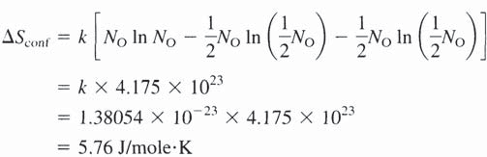
148 Introduction to the Thermodynamics of Materials
mixing is present in any other substance which contains the element, it is customary to ignore it.
4. At any finite temperature a pure crystalline solid contains an equilibrium number of vacant lattice sites, which, because of their random positioning in the crystal, give rise to an entropy of mixing which is exactly the same as the entropy of mixing in a chemical solution. Both the equilibrium number of vacancies and the diffusivity of the atoms in the crystal decrease exponentially with decreasing temperature, and as the vacancies “disappear” by diffusing to the free surface of the crystal, nonequilibrium concentrations of vacancies can be frozen into the crystal at low temperatures, causing a non-zero entropy at 0 K. Random crystallographic orientation of molecules in the crystalline state can also give rise to a non-zero entropy at 0 K. Such is the case with solid CO, in which a structure such as can occur. The entropy would have its
maximum value if equal numbers of molecules were oriented in opposite directions and random mixing of the two orientations occurred. From Eq. (4.18) the molar configurational entropy of mixing would be
23
where N_{O} is Avogadro’s Number, 6.0232×10 .
approximation,
Thus, using Stirling’s
Comparison of this value with the measured value of 4.2 J/mole·K indicates that the actual molecular orientations are not fully random.
In view of the above considerations, the statement of the Third Law of Thermodynamics requires the inclusion of the qualification that the homogeneous phase be in complete internal equilibrium.

